Slide 1
Location Incorporator Our Pitch
By
K.S.Venkatram
Gap Analyst, AOEC 2021

Slide 2
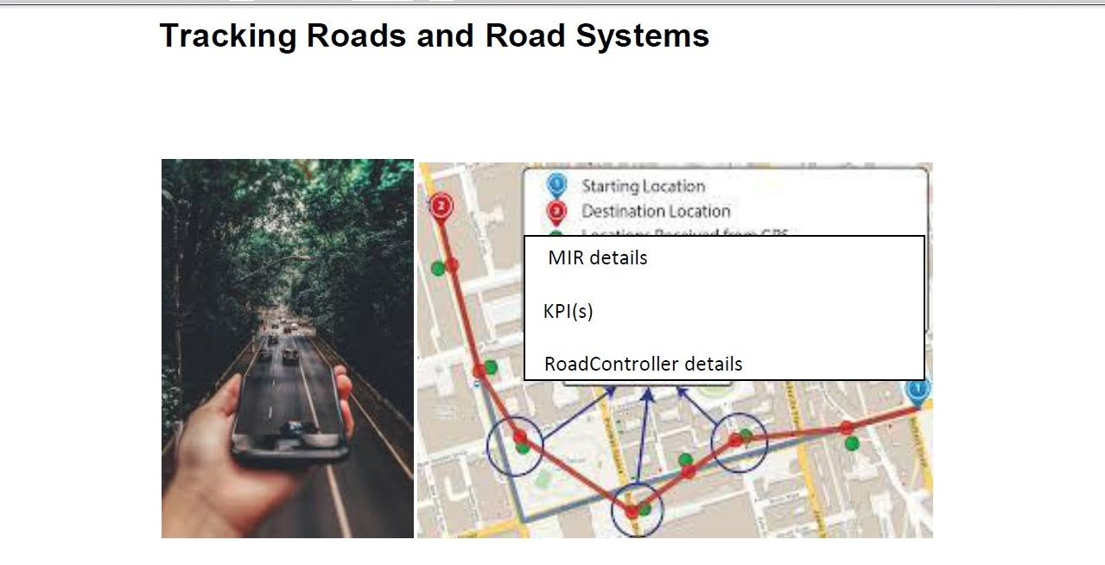

Slide 3
Location Incorporator
Pitch:
We know of hybrid vehicles that switch between ICE to EV.
Tomorrow, this decision making may need to be assisted by a Mobilizer Control Unit that uses RoadMIR Desks and vehicle enabled location data. We find AppLink API(s) and Sync transport services can be used in developing a complete solution for this.

Slide 4
Location Incorporator
Vision:
Machine learning algorithms are being incorporated in many areas of problem solving. We think that tomorrow Location Choreographed Grids could decide modes of operations of vehicles, as location analytics could report the availability of refueling/battery recharging/vehicle maintenance facilities, infrastructure and at-site services that can help people commute

Slide 5
Location Incorporator
The solution finding:
The problem solving called "Location Incorporator" is a solution that expects to use location data from a vehicle (*Ford or Lincoln or any other vehicle) to instantiate sustainable recommendations for the mode in which a vehicle must run. The problem solving incorporates this in a proof of concept website created for Drive-India showcasing driver guidelines and safer commuting. We are still work in progress.

Slide 6
Location Incorporator
As we are participating from India:
Currently, the problem solving will design a solution independent of the need for the Ford Connectivity API(s). There are many APIs that can be used to obtain location data from a vehicle or device in a vehicle, which we have tried to use.
As location data is typically Latitude, Longitude and in some scenarios chronological quotients associated with the location, we improve upon this concept to add a sphere of control for a location.

Slide 7
Location Incorporator
The sphere of control (SOC) for a location can be (a) ASSET RADII or (b) Associated SMART Cloud clusters
As the First version of the sphere of control: ASSET RADII can include indicators for Re-fuelling facilities, Battery recharge facilities, Vehicle Maintenance facilities and Supply chain specific facilities. Tomorrow with the onset of Alternate fuels in vehicles, there may be Alternate Fuelling facilities. If vehicles were to run using solar energy, there would be solar panel / system facilities.

Slide 8
Location Incorporator
For Sphere of Control that includes ASSET RADII, the problem solving proposes the implementation of RoadKPI(s) and RoadMIR Desks, where this has been described in the proof of concept site for road engineering and safer commuting. The proof of concept URL being
www.venkataoec.wixsite.com/safercommuting

Slide 9
Location Incorporator
Details:
In-vehicle data can be used from a mobile app or website, but tomorrow the same mobile app or website can learn from a Location Choreographed Grid to recommend modes of performance to drivers or controllers in the vehicle.

Slide 10
Location Incorporator
A vehicle is known to function either in the Automotive mode, where a Human Machine Interface and/or a Control System Machine Interface inter-operates with the vehicle’s on-board computer / systems to decide performance, vehicle operation or commuting experience.

Slide 11
Location Incorporator
The problem solving ideates to propose a Choreograph mode where notifications and/or alerts are sent to the driver at first and then in subsequent editions to a vehicle’s Mobilizer Control Unit, CU control system/application.
The notifications or alerts are either prescriptive, performance based or carbon equivalent based.
The Choreographed locations will appear in mandatory traffic signs and warning traffic signs on roads, where a Choreographed location indicates the location has details information important for a driver.

Slide 12
Location Incorporator
The location could have KPIs) that need to be related to and could need newer Location Incorporation in terms of Risk admittance or adjustments for synchronized performance, vehicle operation or traffic experience.
A location’s Location choreograph will essentially mean added Advocation, Orchestration and Conditioning (A-O-C) parameters for responsive automotive operations or adjusting control system cycles as a vehicle’s coordinates change (here this is more of incorporating alignment for a new Sphere of control associated with a location or its coordinates).

Slide 13
Location Incorporator
The Location Incorporator will be designed as Dashboard that displays different Location choreograph details, where in addition to different panels, 3 buttons will need to be incorporated, that is an autoChorerograph button, an autoReset button and a LocationIncorporatorLookup button.
The autoChoreograph button will initiate the location incorporation in terms of responsive automotive operations or adjusting control system cycles
The autoReset button will reset the location incorporation

Slide 14
Location Incorporator
The LocationIncorporatorLookup button will lookup the Location choreograph for what is termed as in radius locations, or for a SMART Cloud cluster of importance to the driver of the vehicle. The request for a lookup will be broadcasted to RoadMIR Desks in the proximity defined, where a RoadMIR Desk will process the request and either log the request only if it finds it need not reply or log the request and send a response to the in-vehicle system or device requesting information. There is more to all this, but this is our highlight for this hackathon…

Slide 15
Thank you Good luck to Ford for improving in-vehicle connectivity, control and coordination
Proof of concept website
www.venkataoec.wixsite.com/driveindia

